Slide 1
REPORT WRITING
Michael Buccola (IL)
Renée Kyser (AL)
Tom Sullivan (IN)

Slide 2
Why?
IFTA AM – A660
.100 Licensee
.200 Interjurisdictional
IRP APM – Article 6 Audit Reporting

Slide 3
REPORT WRITING
Technical writing
Crutch words
Word count, Syllable count
Audience
Standard language
Avoid repetition
White space

Slide 4
Technical Writing
Clear
Concise
Descriptive

Slide 5
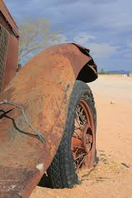
Crutch Words
Crutch words modify without adding information, so they make your writing feel flat and repetitive while making you, the author, appear indecisive
cpgauger.com

Slide 6
Crutch Check
Crutch words are:
Unnecessary
Added out of habit
Writing “Comfort food”
Enemy of concision
Do you repeatedly use a word that can be removed without significantly changing the meaning? If so, it may be your crutch!

Slide 7
Example – Crutch Word
These audited jurisdictional distances were then transferred to the appropriate section of the jurisdiction distance report.
These audited jurisdictional distances were transferred to the appropriate section of the jurisdiction distance report.

Slide 8
Word Count
Read it aloud
Are you droning on?
Can you
remove words?
use shorter words?
reword to simplify?

Slide 9
Example – Concision
There are five vehicles that traveled.
Five vehicles traveled.
On the occasion of…
In a situation in which…
Under circumstances in which…
When

Slide 10
Example – Concision
It is a matter of importance to the accountability of any trucking company with a history of audit issues that the company avoid implementing the type of system that only offers a minimal level of reliability.
Any company with a history of inadequate audit ratings should implement an effective distance/fuel accounting system.

Slide 11
Audience
Who will read the report?
Do they understand the audit process?
What might they question?

Slide 12
Standard Language
Adjustments
Internal controls
Audit techniques used
Recordkeeping requirements

Slide 13
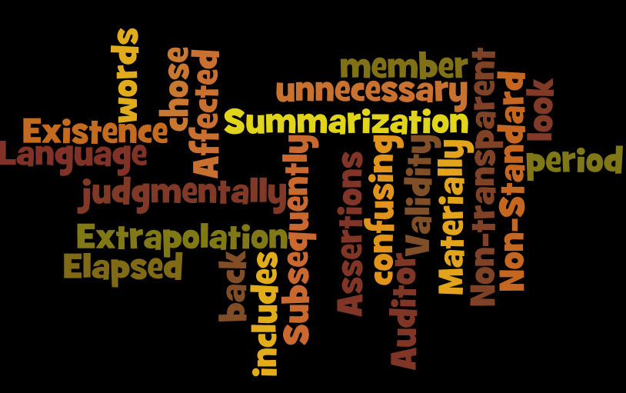
Non-Standard Language
Affected member
Subsequent to
Auditor judgmentally chose
The look back period
Extrapolation

Slide 14
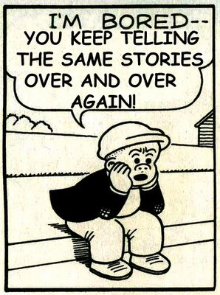
Avoid Repetition
Say it once, make it clear, move on.
Subheadings
Report sections
Combine sentences

Slide 15
Use White Space
Avoid the density of long paragraphs and add interest with:
Bullet points
Numbered lists
Paragraph breaks

Slide 16
Would you rather read this…
Explanation of Adjustments: The origins, stops and destinations for each trip were entered into the audit database. A database function was used to route the trips and determine distance by jurisdiction for each trip. The database summed the distance by jurisdiction by truck for each quarter. The distance determined using the audit database is referred to in this report as verified distance.
Notes:
The next few slides illustrate the increased readability stemming from the changes we have discussed. The original writings are from actual reports.
Use the fewest words to describe the procedure and the result.

Slide 17
Or this?
Explanation of Adjustments: Verified
jurisdictional distance was determined by
routing all recorded origins and
destinations, using a computerized
routing program. The results were summed by unit and jurisdiction.
Notes:
The changes result in a shorter description of the adjustment, without losing the detail.

Slide 18
Would you rather read this…
Adjustment #3 - Audited Jurisdictional Taxable Distance
Audited jurisdictional distance was determined using both the reported taxable distance and the verified taxable distance. Due to limitations in the taxpayer’s fuel tax accounting system, an appropriate level of confidence regarding the reported and the verified taxable distance could not be achieved. The limitations are listed in the internal control weakness section.
Notes:
Avoid repeating information that is detailed in another section.
If you use terms like “as detailed in another section” with a description of the details, the passage can probably be removed.

Slide 19
Cont’d…
For each jurisdiction in each quarter, reported taxable distance was compared to verified taxable distance. The greater of the two amounts is recognized as audited taxable distance for that jurisdiction.

Slide 20
Or this?
Adjustment #3 - Audited Jurisdictional Taxable Distance
Audited jurisdictional distances were determined by selecting the larger of the reported or verified jurisdictional distance.

Slide 21
Would you rather read this…
Justification for Inadequate Ratings: The trip reports presented did not include odometer readings. The trip reports presented did not include routes of travel. The trip reports presented did not include the distance by jurisdiction or total trip distance.

Slide 22
Or this?
Justification for Inadequate Ratings: The trip reports did not detail:
Odometer readings
Routes of travel
Jurisdictional distance
Total trip distance
or
The trip reports did not detail odometer readings, routes of travel, jurisdictional or total trip distance.

Slide 23
Would you rather read this…
Recommendations:
The taxpayer should continue to provide distance reports with the required items of dates of trips, beginning and ending trip odometer readings, routes of travel, and origins and destinations including starting and ending points of travel. Also, the taxpayer should provide the required item of total trip distance, and the jurisdictional distance should be recorded for each trip.

Slide 24
Cont’d…
Also, the taxpayer should check the total and jurisdictional distance to make sure that the correct distances are reported. The taxpayer should also continue to provide monthly and/or quarterly vehicle distance and fuel summaries and a vehicle mpg analysis, especially if the taxpayer increases their fleet to more than one vehicle.

Slide 25
Or this?
Recommendations:
The taxpayer should maintain distance reports detailing the:
Trip date
Beginning and ending trip odometer readings
Routes of travel
Trip origin and destination
Distance per jurisdiction
Total trip distance

Slide 26
Cont’d…
Monthly and quarterly vehicle distance and fuel summaries and vehicle mpg analyses should be maintained.
The reconciled summaries should be utilized when reporting the total and jurisdictional distance.

Slide 27
Would you rather read this…
Records provided:
Mr. X presented the following information: manual monthly trip worksheets, including the total distance generated. After the record inspection was conducted, the registrant provided monthly distance summaries. Registrant provided manual “distance fuel per day” state worksheets. The distance sheets for the audit period for 2012 and 2013 were inadequate. The auditor reviewed the 2014 registration year distance sheets and found the records in compliance. Mr. X explained that

Slide 28
Cont’d…
directions on the requirement for obtaining the apportioned plate was updated. The auditor verified the distance reported in the registrant’s application for apportioned registration and evaluated the accuracy of the registrant’s distance accounting system. Mr. X’s distance accounting system does not meet the requirements under Article X Records and Audits. The records are inadequate under section 1005 of Article X. The IFTA MFUT-15 Quarterly Returns were provided and prepared by ZZ, Inc. located in Anywhere, N.A.

Slide 29
Cont’d…
AUDIT FINDINGS:
Registration year 2012 and 2013 distance did not match the distance at renewal. Auditor found the records for registration year 2012 and 2013 to be inadequate. In accordance with the International Registration Plan records that are not made available, or are determined inadequate, will be assessed twenty percent (20%) of the fees paid to EACH jurisdiction during the year(s) under audit.

Slide 30
Or this?
RECORDS PROVIDED:
Mr. X presented the following records:
Manual monthly trip worksheets detailing the total distance
Monthly distance summaries
Manual daily jurisdictional fuel worksheets
ZZ, Inc., Anywhere, N.A. presented the following:
IFTA MFUT-15 quarterly returns

Slide 31
Cont’d…
AUDIT FINDINGS:
The auditor verified the distance reported in the registrant’s application for apportioned
registration and evaluated the accuracy of the registrant’s distance accounting system.
Registration years 2012-13
The trip worksheets did not contain the required information. In addition, the sum of the
worksheet-recorded jurisdictional distance did not match the reported jurisdictional distance.

Slide 32
Cont’d…
Since the auditor found the distance accounting system did not meet the requirements detailed in Article X of the International Registration Plan, the registrant was assessed a fee equal to twenty percent (20%) of the fees paid to EACH jurisdiction for these years.
Registration year 2014
The registrant’s distance records were in compliance and were accepted as reported.

Slide 33
Open Discussion
Some inter-jurisdictional audit reports
include adjustments and assessments in the same document. Others include the adjustments in the audit report and the assessment in a billing report. What are the advantages and disadvantages of each method?

Slide 34
Notes:
This is just a part of the form…

Slide 35
Open Discussion
Multi-year, multi-fleet, multi-program audits
Combined report
vs.
Separate reports

Slide 36
Open Discussion
Adequate / Inadequate
Rating the Internal Controls
vs.
Rating the records as a whole

Slide 37
Open Discussion
For inadequate ratings, is it better to:
cite IRP 1015 or IFTA A550
or
provide an explanation

Slide 38
Open Discussion
Report signed by reviewer and auditor
vs.
auditor’s signature only
Notes:
Is there any value in having both? What are the advantages and disadvantages of each style?
Does it show more support for audit results?
Is the extra time needed for and additional signature worth the delay?
Would the taxpayer notice?

Slide 39
Open Discussion
Some jurisdictional audit reports include
separate sections for remarks and
recommendations, while others separate
the remarks section from the
recommendations section.

Slide 40
Open Discussion
Are there advantages to including separate sections for the audit procedures employed?
Or
Is it better to include this discussion in the adjustment section of the audit report?

Slide 41
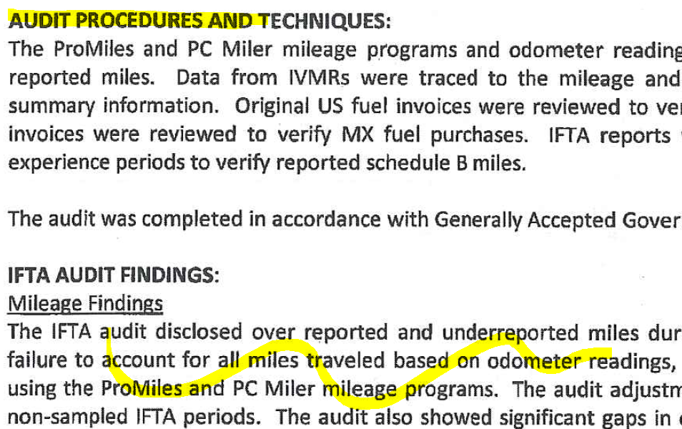

Slide 42
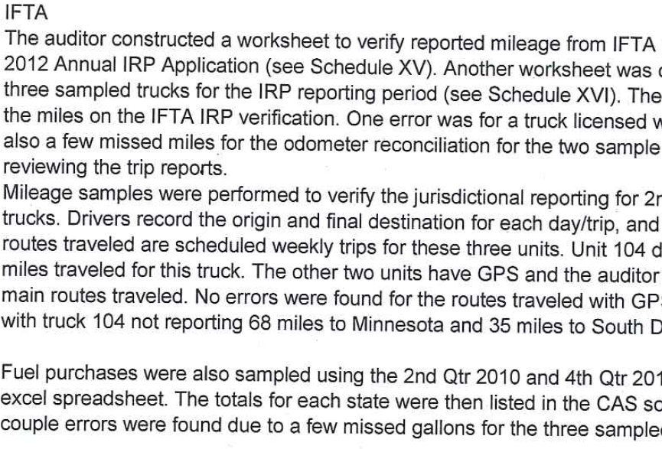

Slide 44
Mike Buccola Renée Kyser Tom Sullivan
Rev Agent Rev Examiner Audit Super
Accounting Rev. MV Div, Audit Special Tax Div.
IL SOS AL DOR IN DOR
312-305-0046 334-493-0053 317-910-9471
A very special thanks to Monica Halstead, IN DOR

